Slide 1
Tensor Network code : Part-I
Outline
Tensor Network Notation (TNN)
Tensor Operations
Tensor Networks
Stabilizer codes as tensors
Generating new stabilizer codes
Code distance via tensor network
Maximum Likelihood decoding (MLD) via tensor network

Slide 2




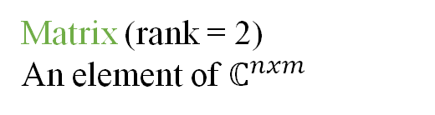





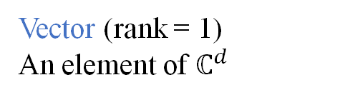















Introduction to Tensor Network Notation (TNN)
Tensors?
Generalisation of vectors and matrices
Dimension (d): Number of values an index can take
Rank (r) = Number of indices = Number of legs
Einstein Notation
TNN
Vector (rank = 1)
An element of $ℂ^{d}$
$$v=\left[\begin{aligned}1 \\ 2\end{aligned}\right]$$
$$v_{i}$$
$$v$$
$$i$$
Matrix (rank = 2)
An element of $ℂ^{nxm}$
$$M=\left[\begin{matrix}2 & 4 \\ 1 & 3\end{matrix}\right]$$
$$M_{ij}$$
$$i$$
$$M$$
$$j$$
$$\left[\begin{matrix}2 & 4 \\ 1 & 3\end{matrix}\right]$$
Rank-3 tensor
R $= \left[\begin{matrix}1 & 3 \\ 5 & 2\end{matrix}\right]$
$$R_{ijk}$$
$$i$$
$$R$$
$$k$$
$$i_{1}$$
$$i_{2}$$
$$i_{3}$$
$$i_{r}$$
$$T_{i_{1}i_{2}i_{3}…i_{r}}$$
$$j$$
Rank-r tensor
An element of $ℂ^{d_{1} × d_{2} × … ×{ d}_{r}}$
$$……………$$
$$T$$

Slide 3




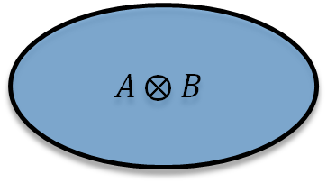
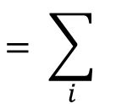




Tensors Operations
(1) Tensor product: Element-wise product of the values of each constituent tensor
$$A ⨂ B$$
${[A ⨂ B]}_{i_{1}{,… i}_{r},j_{1}…{ j}_{s}}$:= $A_{i_{1}, …i_{r}}∙B_{j_{1}, …j_{s}}$
$$A$$
$$B$$
$:$=
(2) Trace (partial): If $xth$ and $yth$ indices have identical dimensions ($d_{x}=$ $d_{y}=bond dimension) of tensor A;then,$
${[{Tr}_{x,y} A]}_{i_{1}{, …,i_{x−1},i_{x+1, …,}i_{y−1},i_{y+1, …,}i}_{r} }$:= $\sum_{α=1}^{d_{x}}{A_{i_{1}{, …,i_{x−1},{α,i}_{x+1, …,}i_{y−1},{α,i}_{y+1, …,}i}_{r}}}$
Bond
$$i$$
:=
$${Tr}_{Right}$$
$$= \sum_{i}{}$$
$$i$$

Slide 4





















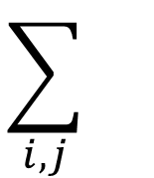



Tensors Operations
(3) Contraction: Tensor product followed by a trace between indices of two tensors.
Internal Indices: Bonds, here i and j
External Indices: free legs
$$i$$
$$i$$
$$\sum_{i,j}{}$$
:=
$$A$$
$$B$$
$$A$$
$$B$$
$$j$$
$$j$$
Examples:
Conventional
$\overset{→}{x}$ $. \overset{→}{y}$
$$\overset{→}{v}$$
$$M$$
$$AB$$
$$Tr(X)$$
Einstein
$$x_{α}y_{α}$$
$$M_{αβ}v_{β}$$
$$A_{αβ}B_{βγ}$$
$$X_{αα}$$
TNN
$$x$$
$$y$$
$$M$$
$$v$$
$$A$$
$$B$$
$$X$$
Inner Product
Matrix-vector multiplication
Matrix-matrix multiplication
Trace of a matrix

Slide 5



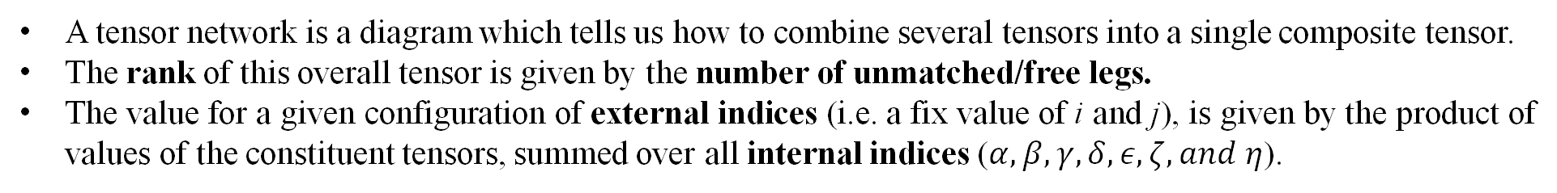


















Tensor Networks
A tensor network is a diagram which tells us how to combine several tensors into a single composite tensor.
The rank of this overall tensor is given by the number of unmatched/free legs.
The value for a given configuration of external indices (i.e. a fix value of i and j), is given by the product of values of the constituent tensors, summed over all internal indices ($α,β,γ,δ,ε,ζ, and η$).
$$i$$
$$j$$
$$i$$
$$j$$
$$γ$$
$$γ$$
$$∏$$
=
:=
$$\sum_{\begin{aligned}α,β,γ,δ, \\ ε,ζ,η\end{aligned}}{}$$
$$β$$
$$α$$
$$ε$$
$$where,$$
$$ε$$
$$ζ$$
$$η$$
$$β$$
$$δ$$
$$ζ$$
$$η$$
$$α$$
$$δ$$

Slide 6








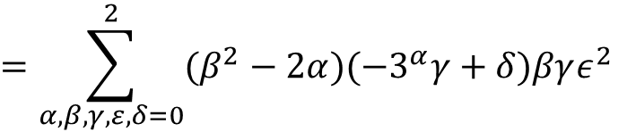

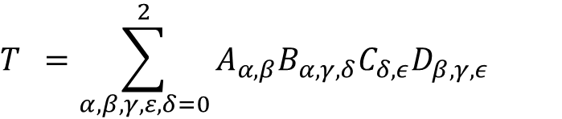












Tensor Networks
Example
$$A$$
$$β$$
$$β$$
$$D$$
$$=−3^{α}−2α$$
$$= β^{2}−2α$$
$$A$$
$$D$$
$$γ$$
$$α$$
$$ε$$
=
$$T$$
$$α$$
$$ε$$
$$γ$$
$$B$$
$$C$$
$$=−3^{α}−2α$$
$$= ε$$
$$B$$
$$δ$$
$$δ$$
$$C$$
$$T =\sum_{α,β,γ,ε,δ=0}^{2}{A_{α,β}B_{α,γ,δ}C_{δ,ε}D_{β,γ,ε}}$$
$$=\sum_{α,β,γ,ε,δ=0}^{2}{(β^{2}−2α)(−3^{α}γ+δ)βγε^{2}}$$
Internal Indices: All
External Indices: None
All indices are 3-dimentional
$$=1080$$

Slide 7



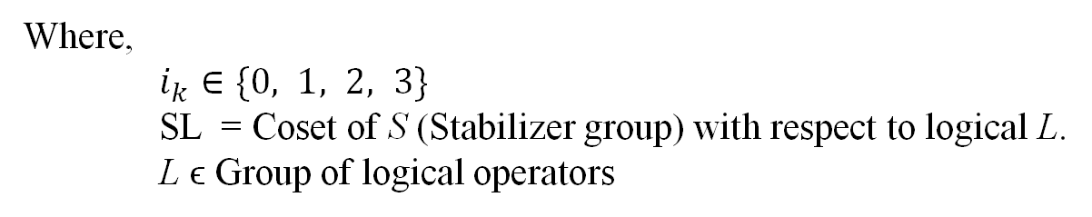





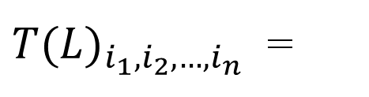

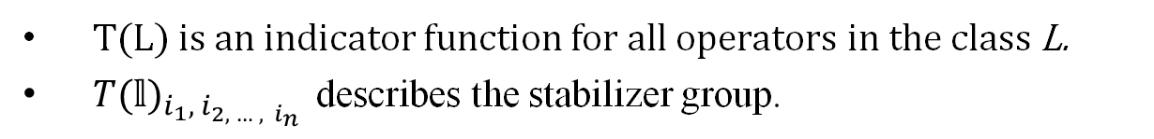
Stabilizer codes as Tensors
Represent Pauli operators by strings of integers.
$$I= σ^{0}, X= σ^{1}, Y= σ^{2}, Z= σ^{3}$$
$Ex. XZZXI= σ^{1}σ^{3}σ^{3}σ^{1}σ^{0} as the string (1, 3, 3, 1, 0)$
For a stabilizer code with n physical qubits, and k logical qubits, define the rank-n tensor for each logical operator L (ϵ Group of logical operators).
$$1 if σ^{i_{1}}⨂∙∙∙{⨂σ}^{i_{n}}∈SL$$
$$i_{1}$$
$$i_{2}$$
${T(L)}_{i_{1},i_{2},…,i_{n}}$ =
$$i_{n}$$
$$i_{3}$$
$$0 otherwise$$
$$T(L)$$
Where,
$i_{k}∈\{0, 1, 2, 3\}$
SL = Coset of S (Stabilizer group) with respect to logical L.
L ϵ Group of logical operators
$$i_{k}$$
Seed tensor
T(L) is an indicator function for all operators in the class L.
${T(𝕝)}_{i_{1},{ i}_{2, … ,{ i}_{n}}}$ describes the stabilizer group.

Slide 8

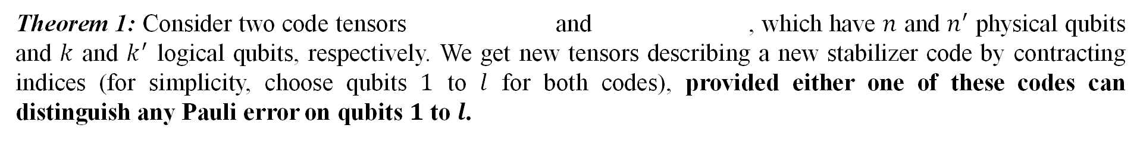
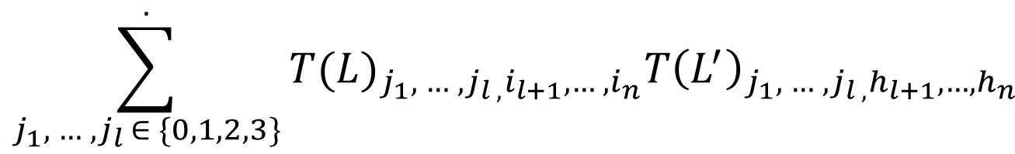
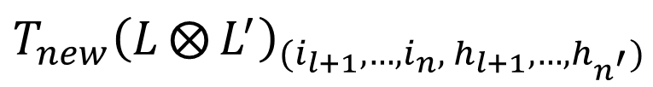


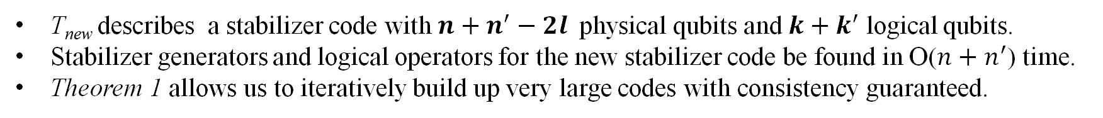
Generating new stabilizer codes
Contracting seed tensors generates larger codes.
But how to check if the newly formed code is also a stabilizer code?
Theorem 1: Consider two code tensors and , which have $n$ and $n^{′}$ physical qubits and $k$ and $k^{′}$ logical qubits, respectively. We get new tensors describing a new stabilizer code by contracting indices (for simplicity, choose qubits $1$ to $l$ for both codes), provided either one of these codes can distinguish any Pauli error on qubits $1$ to $l$.
${T(L)}_{i_{1},i_{2},…,i_{n}}$
${T\left(L^{′}\right)}_{h_{1},h_{2},…,h_{n^{′}}}$
${T_{new}\left(L⨂{L^{′}}\right)}_{(i_{l+1},…,i_{n},{ h}_{l+1},…,h_{n^{′}})}$
$$\sum_{j_{1},{ …, j}_{l }∈ \{0,1,2,3\}}^{.}{{T(L)}_{{j_{1},{ …, j}_{l ,}i}_{l+1},…, i_{n}}{T\left(L^{′}\right)}_{{j_{1},{ …, j}_{l ,}h}_{l+1},…,h_{n}}}$$
$$=$$
T_{new} describes a stabilizer code with $n+n^{′}−2l$physical qubits and $k+k^{′}$ logical qubits.
Stabilizer generators and logical operators for the new stabilizer code be found in O($n+n^{′}$) time.
Theorem 1 allows us to iteratively build up very large codes with consistency guaranteed.

Slide 9

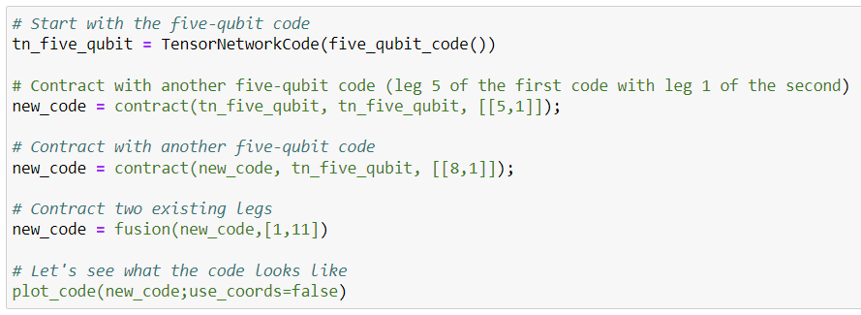
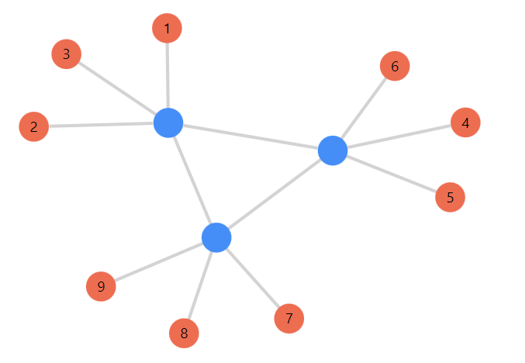
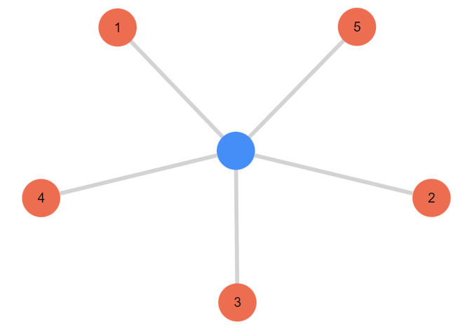
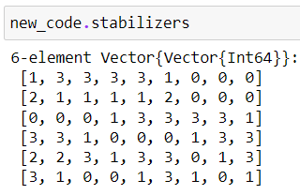
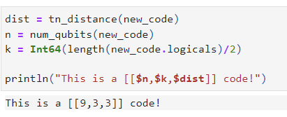
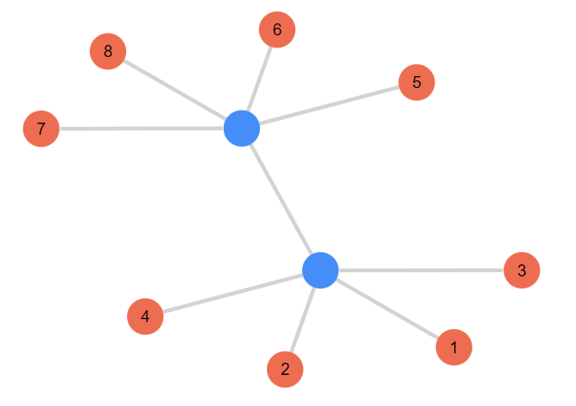
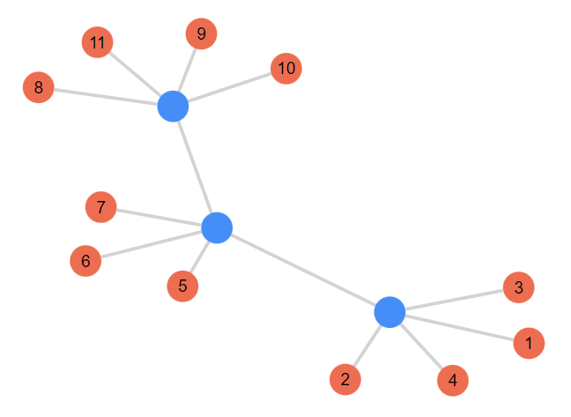
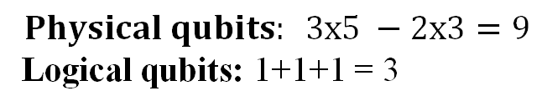
Generating new stabilizer codes
Example
Julia package:
https://github.com/qecsim/TensorNetworkCodes.jl
Distance calculation
[[5,1,3]]
[[9,3,3]]
$$Physical qubits: 3x5 −2x3=9$$
Logical qubits: 1+1+1 = 3
[[13,3]]
[[11,3]]
[[9,3]]
Iterations

Slide 10
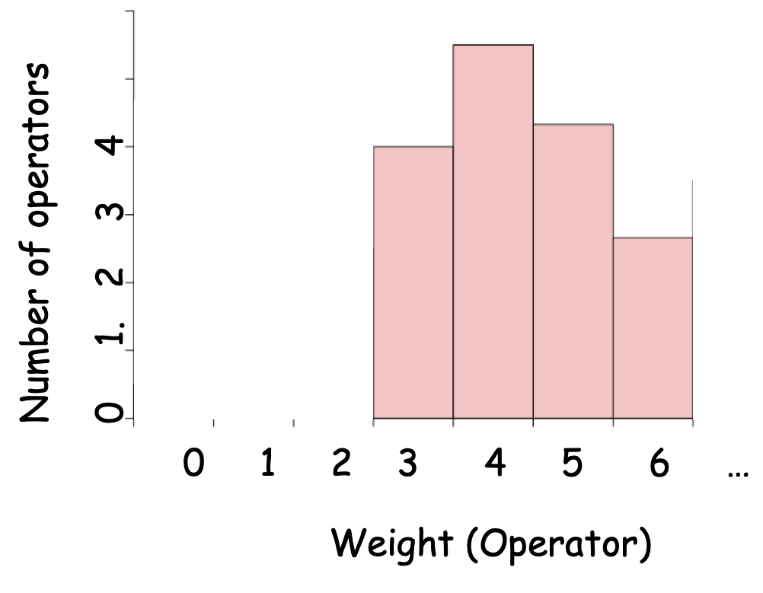
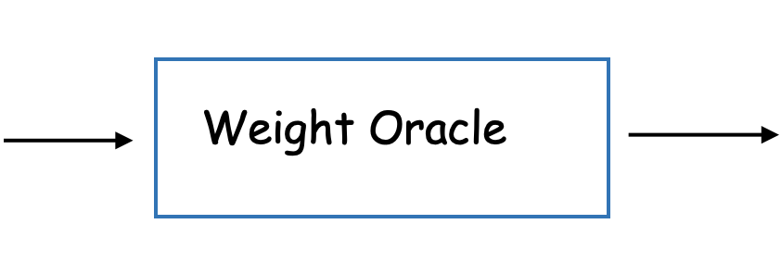
'Code Distance' via Tensor Network
Requirement for an efficient Weight estimator :
Existence of efficient contractable tensor structure in the input code.
In general, finding such structure is NP-Complete but in certain cases we have efficient way to do this.

Slide 11
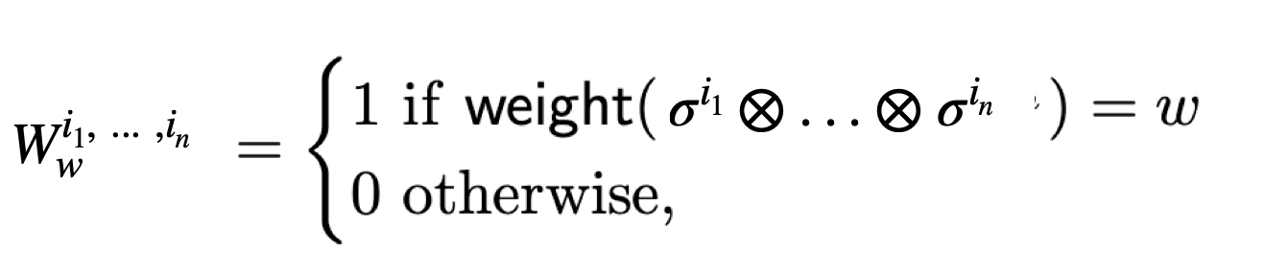
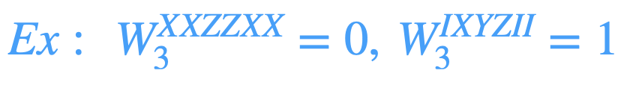
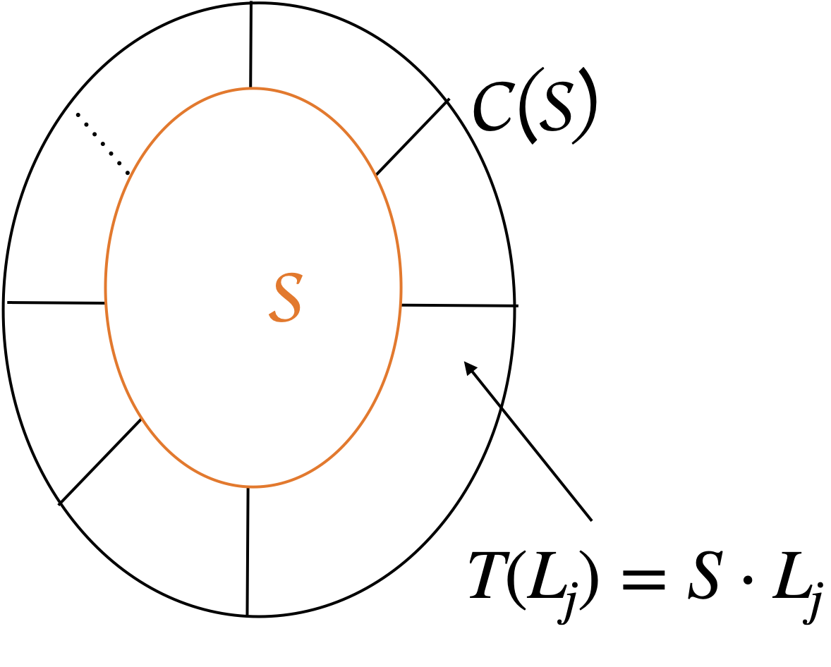
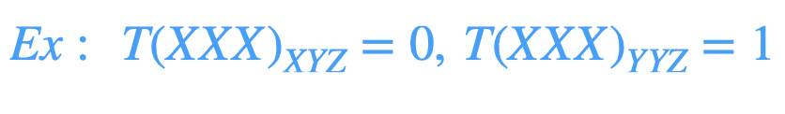
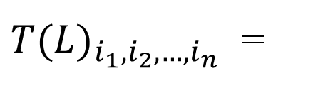


Construction of 'Weight-Oracle'
$$1 if σ^{i_{1}}⨂∙∙∙{⨂σ}^{i_{n}}∈SL$$
${T(L)}_{i_{1},i_{2},…,i_{n}}$ =
$$0 otherwise$$

Slide 12
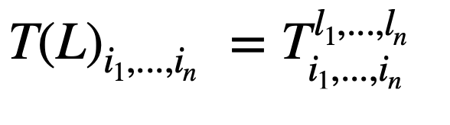
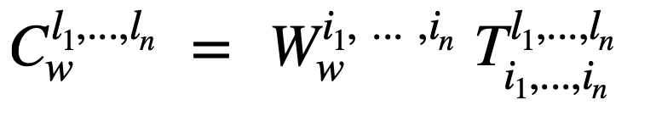
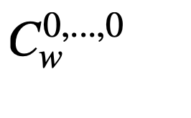
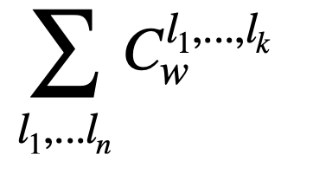

(Continue....)
[ Equivalent Representation]
= Number of stabilizer operator having 'w' weight.
= Number of Centraliser operator having 'w' weight.
= Number of C(S)/S
Operators having 'w' weight.

Slide 13
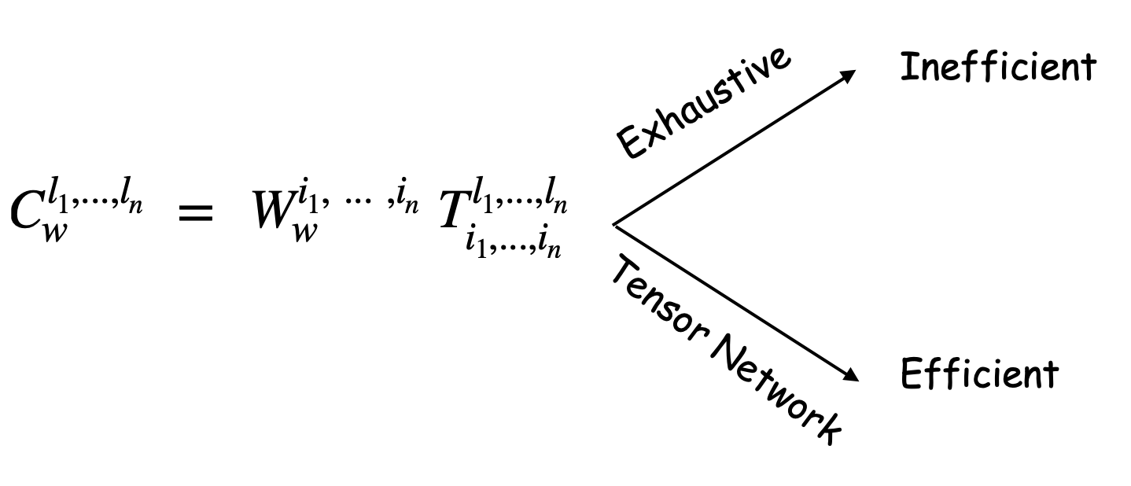
= Number of C(S)/S
Operators having 'w' weight.
Reason for Efficiency of TN strategy:
The above tensor can be computed efficiently if the original code tensor is contractable.
We see an illustration of such efficient contraction for Holographic code

Slide 14
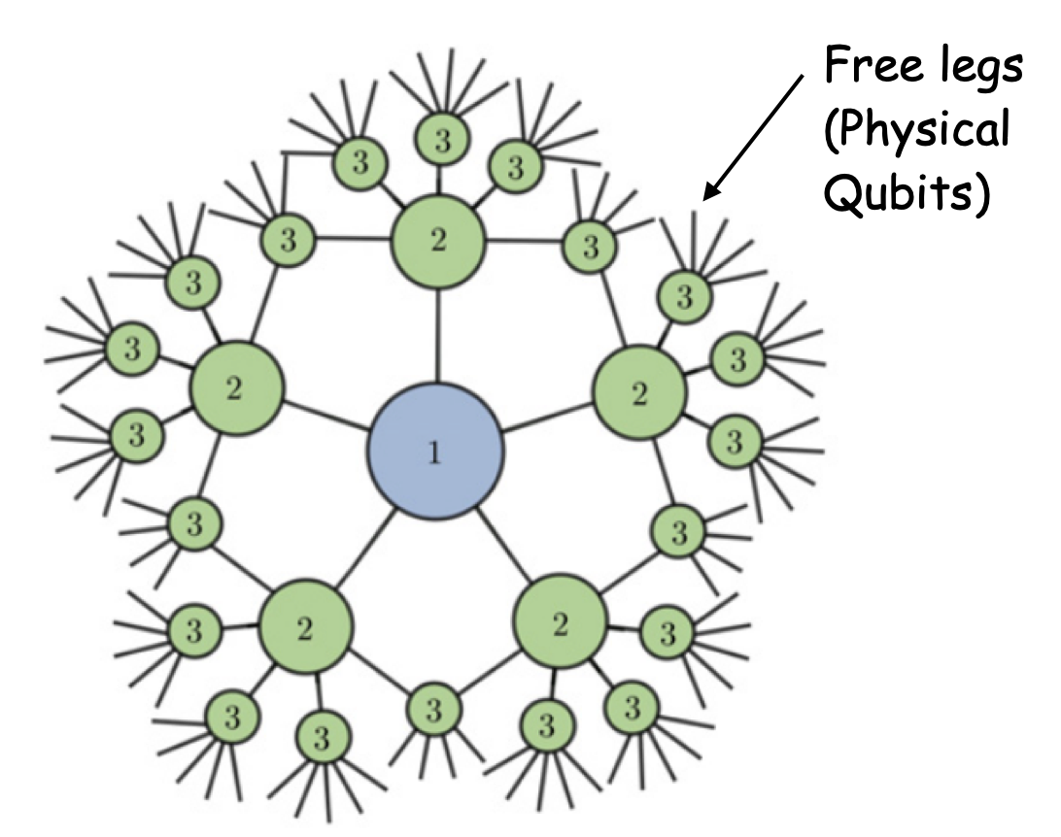
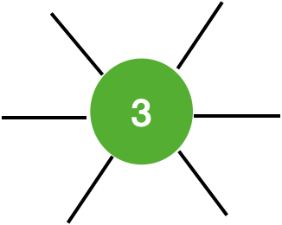
Example: Holographic code tensor [T(L)]
Seed code for the larger code

Slide 15
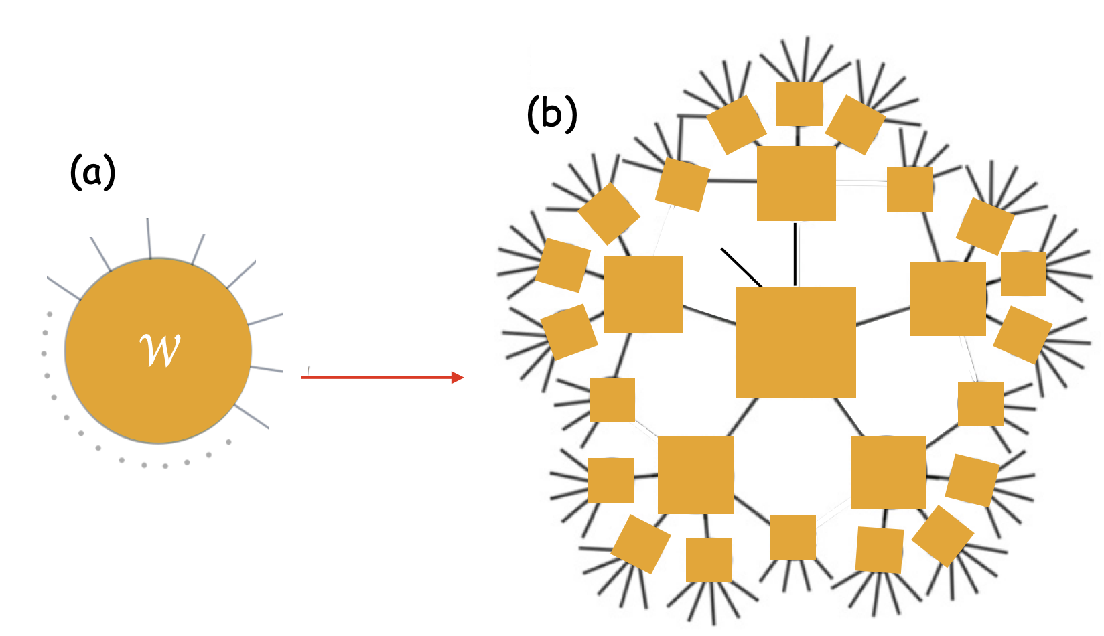
Chaining of Weight tensor (W) for efficient contraction.
Both right and left tensors are same tensor (number of legs are same.)
The right one is given this form so that it can help in efficient contraction (mentioned in the next slide).

Slide 16
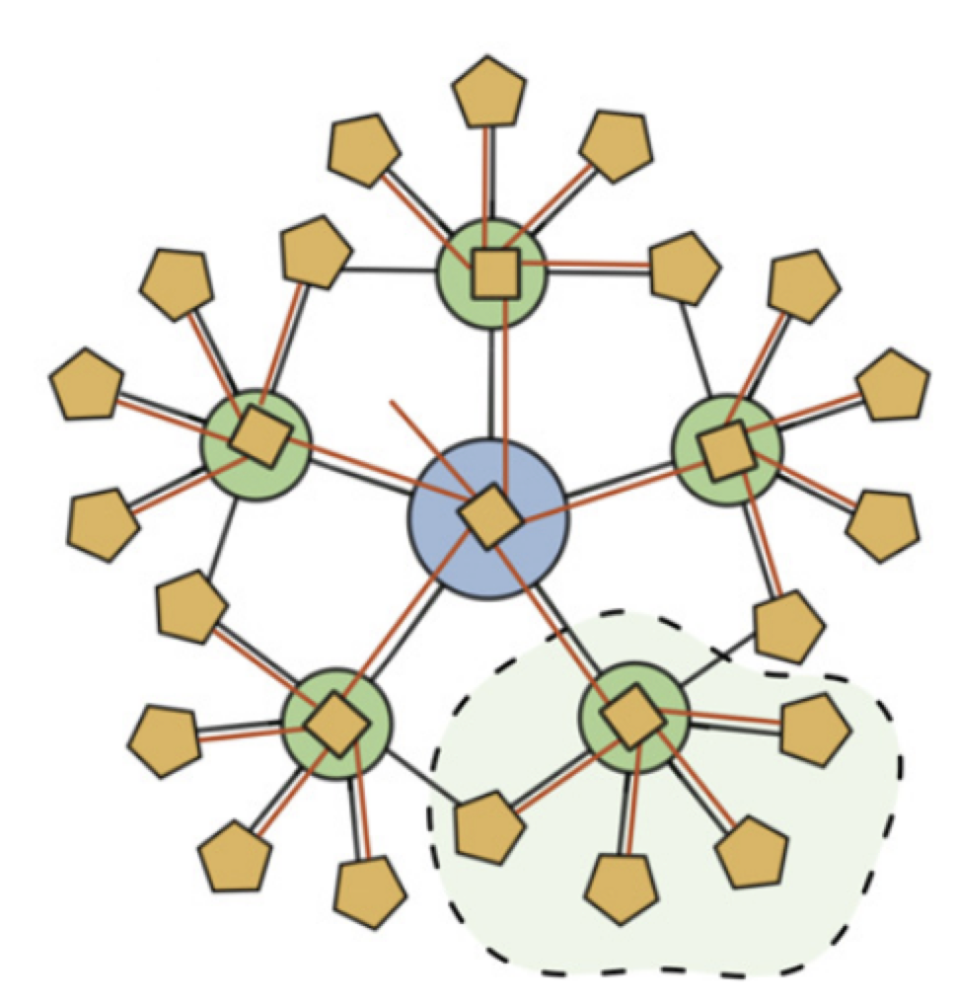
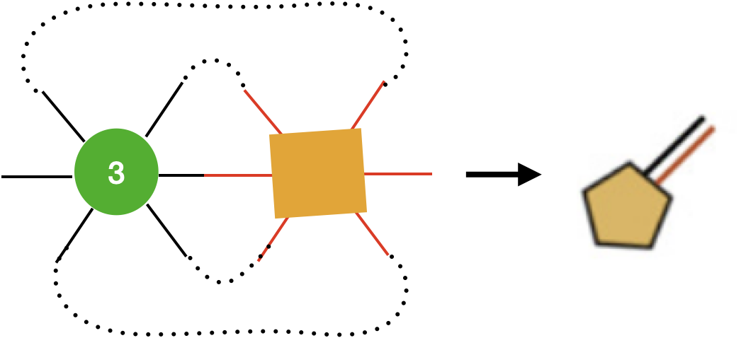
Valid contraction method
Contraction of W and T(L) tensors

Slide 17
Some observation on the contracted tensor
One free leg (at the centre).
It counts number of logical operators with weight 'w'.

Slide 18
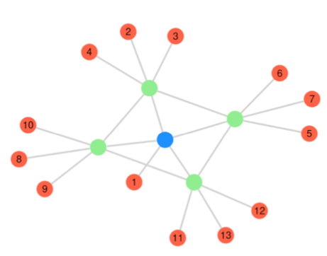
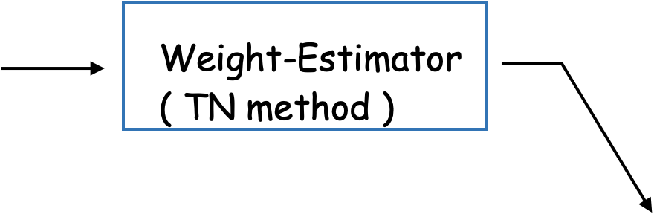
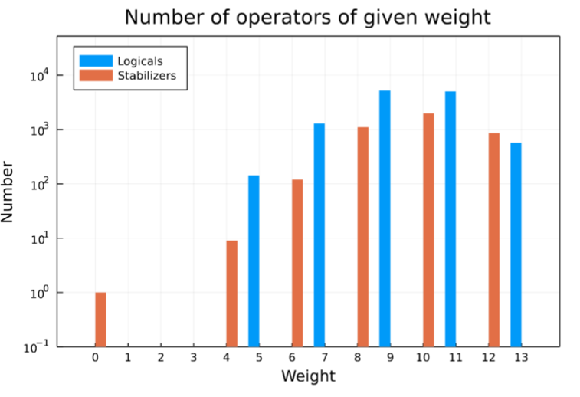
Some statistics for [[13, 1, 5]] tensor code
[[13, 1, 5]]
Useful for:
MERA Tensor network
Local ''Log-Depth'' Circuits

Slide 19
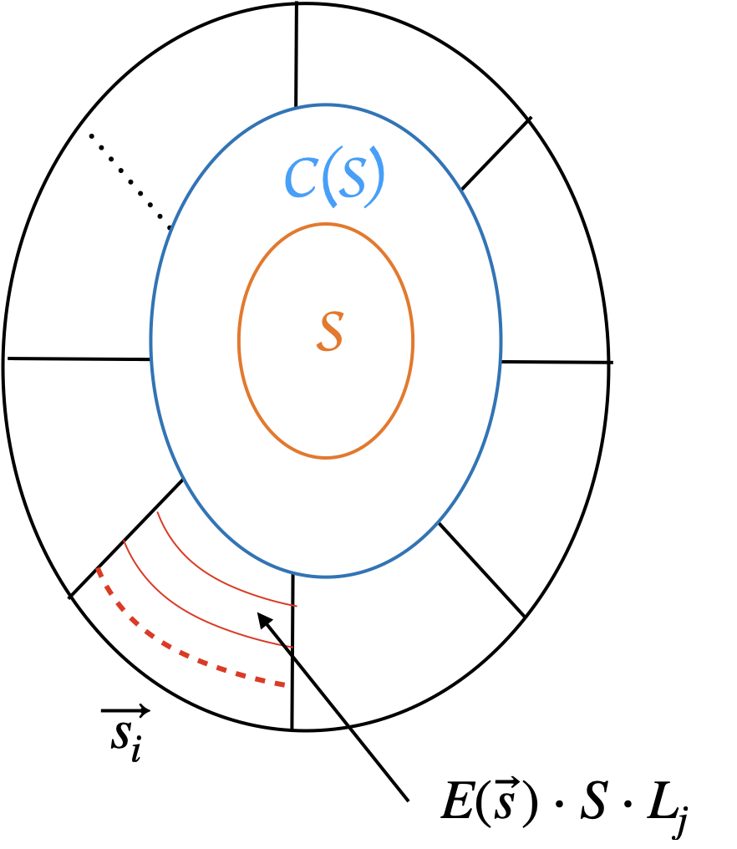
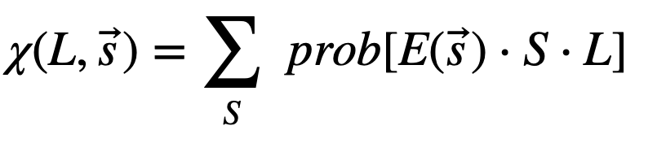
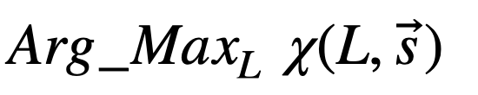

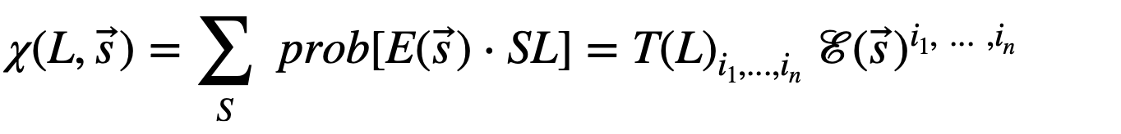
Maximum Likelihood Decoding (MLD): General Strategy
Start with Syndrome Measurement:
Goal:
In general, MLD computation is computationally hard problem (NP-complete).
(Recall) Toric code: MLD complexity
(Claim)

Slide 20



(Continue...)
We have just found tensor structure in MLD estimation.
Efficient tensor contraction Efficient MLD estimation.
Simplification of the tensors under ''Uncorrelated Quantum channel'' assumption
Illustration in next page....

Slide 21

''Uncorrelated Quantum channel''

Slide 22



Efficient Contraction for uncorrelated error model
Code tensor
Result on contraction

Slide 23

Some observation on the contracted tensor
No free legs (Scalar quantity)
It represents
Result on contraction

Slide 24





Results
Codes | MLD (general) complexity | MLD (with TN) complexity | Assumptions
Planar Surface Codes |  |  | Uncorrelated Quantum channel, and a few more.
Holographic Codes (Ex. HaPPY code, 3-Qutrit, etc) |  |  | Uncorrelated Quantum channel and a few more.
Remarks:
Compare Toric code (a surface code) Edmond algorithms
Some more context of uses: MERA, Concatenated and Convolutional codes.

Slide 25
References
Farrelly, Terry, Tuckett, David K., and Thomas M. Stace. "Local tensor-network codes." ArXiv, (2021). Link
Bridgeman, Jacob C., and Christopher T. Chubb. "Hand-waving and Interpretive Dance: An Introductory Course on Tensor Networks." ArXiv, (2016). Link
Farrelly, Terry, Harris, Robert J., McMahon, Nathan A., and Thomas M. Stace. "Tensor-network codes." ArXiv, (2020). Link
https://github.com/qecsim/TensorNetworkCodes.jl
S. Bravyi, M. Suchara, and A. Vargo. Effcient algorithms for maximum likelihood decoding in the surface code. Phys. Rev. A, 90:032326, 2014. Link
Ferris, Andrew J., and David Poulin. "Tensor Networks and Quantum Error Correction." ArXiv, (2013). Link
https://errorcorrectionzoo.org/c/happy

